Slide 1
Queueing Systems with Tandem Servers: Analytical Solutions and Applications in the Transportation Field
Weihua Gu
Department of Electrical Engineering
The Hong Kong Polytechnic University

Slide 2
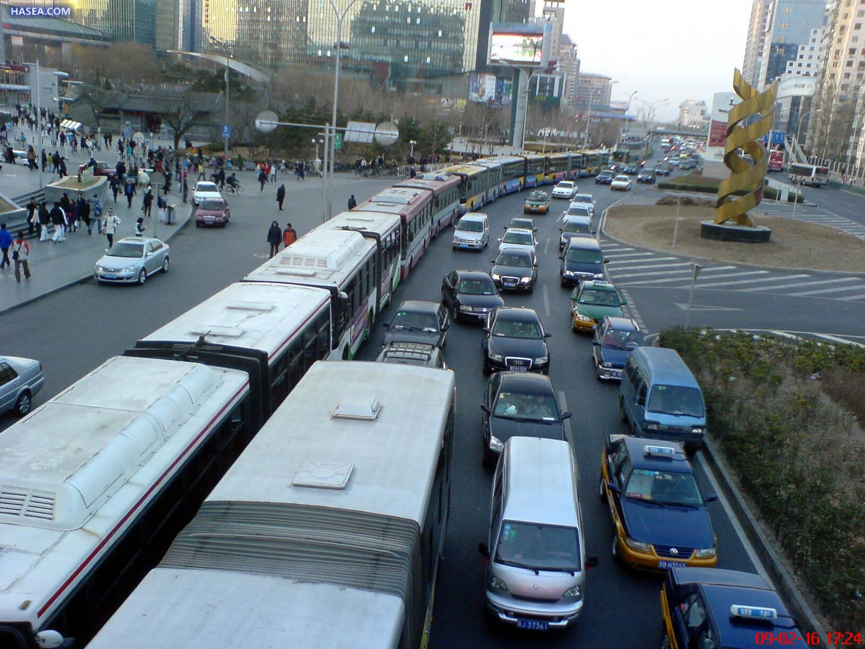

Slide 3
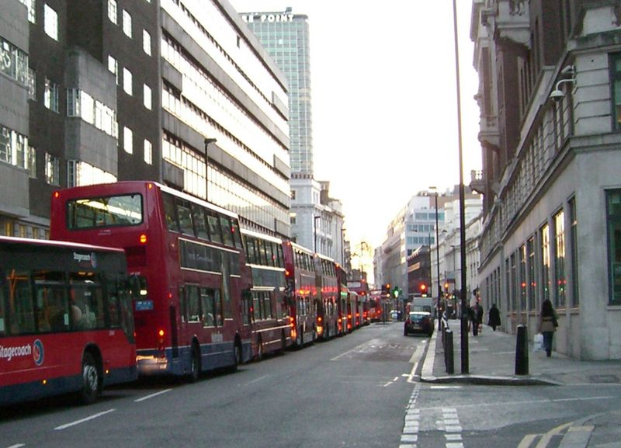

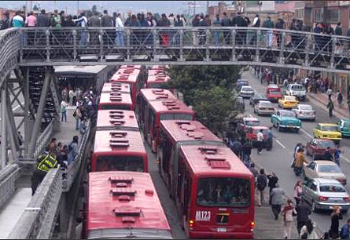
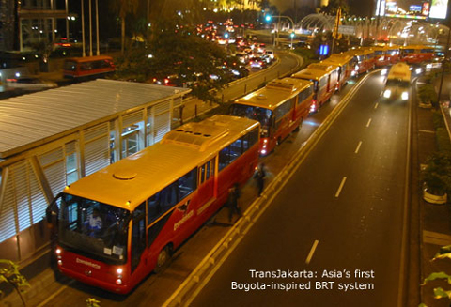
London
Beijing
Bogota
Jakarta
3

Slide 4
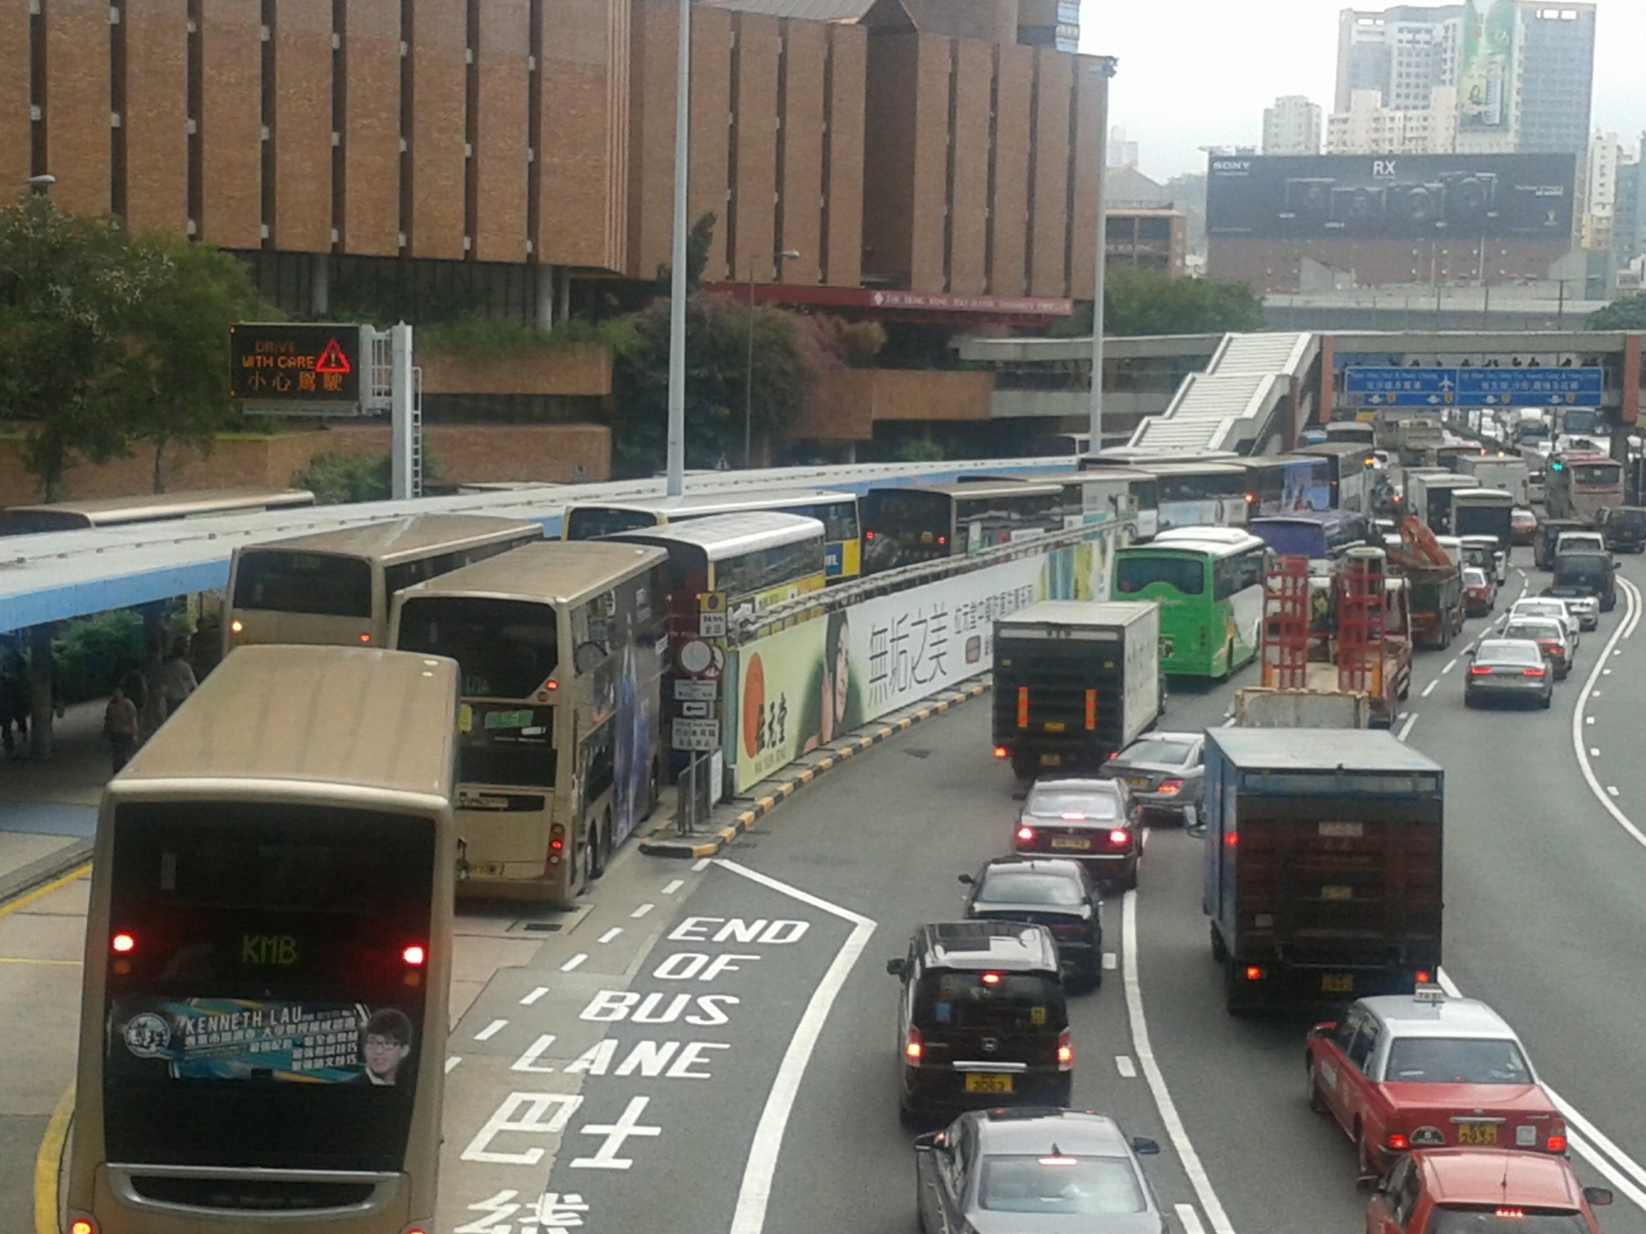

Slide 5
Why is bus stop congestion so common?

Slide 6

Why is bus stop congestion so common?
Maximum bus flow at a non-stop bus lane:
700-800 buses/hr
(e.g., I-495 contraflow bus lane in New Jersey.)

Slide 7
Why is bus stop congestion so common?
At a traffic signal:
300-400 buses/hr

Slide 8
Why is bus stop congestion so common?
At a curbside bus stop:
80-120 buses/hr
Berth
Passenger loading platform

Slide 9
Why is bus stop congestion so common?
Bus stops are often major bottlenecks of a bus system.
To better understand bus-stop congestion, we need a theory of bus-stop queueing.

Slide 10
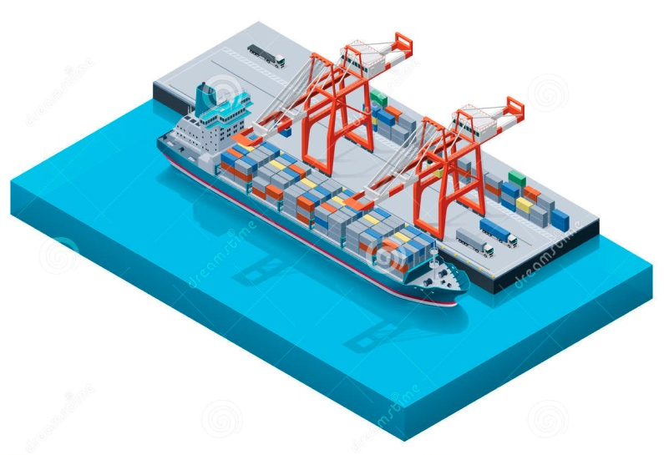

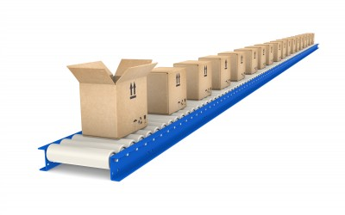
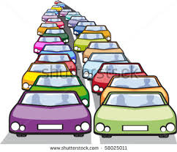

Queueing Theory
Telecommunication
Logistics
Production line
Service queue
Transportation

Slide 11
Classical queueing systems with parallel servers
A queued customer can freely enter any available server; when her service finishes, she can freely leave.
server (the customer experiences
a random service time)
customer
random
arrivals
Queueing
area
Service
area
Notes:
So due to this mutual blockage, the system operation is very different from classic queueing systems that are widely studied in the literature, where servers are laid out in parallel, and customers can freely enter or exit any server.
So traditional queueing models do not work for this special type of queueing systems. And we need develop new models.
Here you may think that the mutual blockage adds to the complexity of the queueing models. But actually thanks to the mutual blockage property, we are now able to derive analytical solutions for a large range of operating conditions of these queueing systems, as we will see momentarily.

Slide 12
Queueing systems with tandem servers
Multi-berth bus stop
berth
Queueing
area
passenger platform
Notes:
So due to this mutual blockage, the system operation is very different from classic queueing systems that are widely studied in the literature, where servers are laid out in parallel, and customers can freely enter or exit any server.
So traditional queueing models do not work for this special type of queueing systems. And we need develop new models.
Here you may think that the mutual blockage adds to the complexity of the queueing models. But actually thanks to the mutual blockage property, we are now able to derive analytical solutions for a large range of operating conditions of these queueing systems, as we will see momentarily.

Slide 13
Queueing systems with tandem servers
Since bus berths are laid out in tandem, bus overtaking maneuvers could be disruptive to other vehicles using or passing the stop. Thus these maneuvers are often prohibited.
Mutual blockage exists between buses that use different berths of the stop.
Sometimes this is also prohibited!
Not feasible!
Passenger platform
Queueing
area
Serving
area
Notes:
You might have noted that in these systems vehicles and passengers often form long queues. This is because of the mutual blockage that exists between those vehicles or people.
Take a bus stop as an example, a bus usually cannot enter an empty downstream berth by overtaking other buses, since it will not be able to maneuver its tail into the berth. And although a bus can exit a berth by overtaking, sometimes this maneuver is prohibited because it might disrupt car traffic in the adjacent lane.

Slide 14
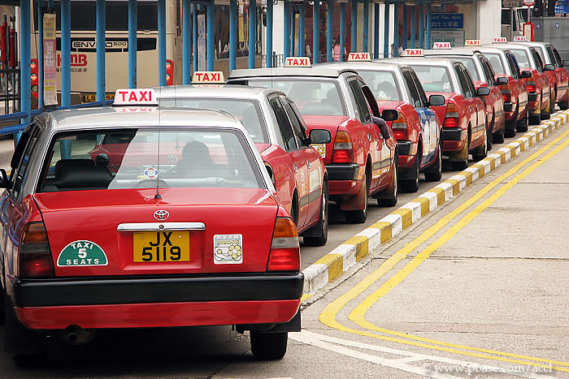
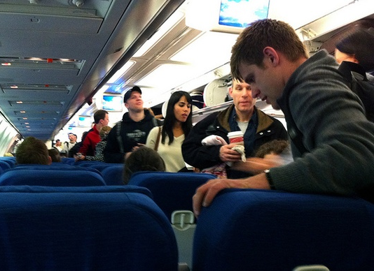
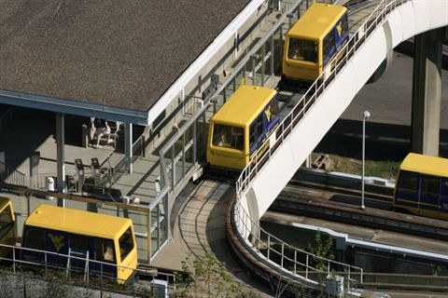
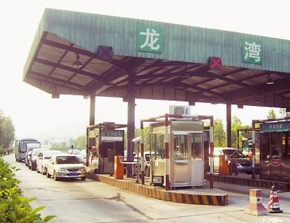
Similar queueing systems
Notes:
Similar systems are commonly seen in the transportation field, for example, taxi station near an airport, personal rapid transit station, and a queue of passengers boarding an airplane. I call these systems “serial queueing systems” because the phrase “tandem queueing system” has been used for other purpose in the literature.

Slide 15


Outline
Multi-berth bus stops
No-overtaking
Limited-overtaking
Bus stops near signalized intersections
Tandem toll booths
Passenger platform
Passenger platform
Bus lane
Passenger platform
Notes:
In the following slides, I will show analytical models developed for tandem bus stops where overtaking maneuvers are completely prohibited - “no-overtaking” stops; and where buses are allowed to overtake other buses only when exiting a berth, which I term as “limited-overtaking” stops.
I will then briefly describe the model for tandem toll booths, and summarize the slides.

Slide 16
References
Gu, W. (2012) Models of Bus Queueing at Isolated Bus Stops. PhD Dissertation. University of California, Berkeley.
Gu, W., Cassidy, M.J., Li, Y. (2014) Models of Bus Queueing at Curbside Stops. Transportation Science 49(2), 204-212.
Gu, W., Cassidy, M.J. (2013) Maximizing Bus Discharge Flows from Multi-berth Stops by Regulating Exit Maneuvers. Transportation Research Part B 56, 254-264.
Gu, W., Cassidy, M.J., Li, Y. (2012) On the Capacity of Highway Checkpoints: Models for Unconventional Configurations. Transportation Research Part B 46(10), 1308-1321.
Gu, W., Li, Y., Cassidy, M.J., Griswold, J.B. (2011) On the Capacity of Isolated, Curbside Bus Stops. Transportation Research Part B 45(4), 714-723.
Notes:
These are the references on which the slides are based.

Slide 17
Literature review
Professional handbooks: Highway Capacity Manual (2000, 2010), Transit Capacity and Quality of Service Manual (2003, 2013), etc.
Analytical models: Ge (2006), Yang et al (2009), Hall and Daganzo (1983), Estrada et al (2011), etc.
Simulation models: Gibson et al (1989), Gibson (1996), Fernandez (2010), Papacostas (1982), St. Jacques and Levinson (1997), Koshy and Arasan (2005), Holt (2004), Wong et al (1998), etc.
Notes:
For tandem bus stops, the models are developed to find … This target average bus delay is used as a metric of service level, and we define this maximum bus discharge flow as the allowable flow of a stop.

Slide 18
We developed analytical models for the general case.

Slide 19
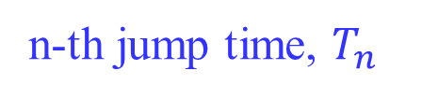
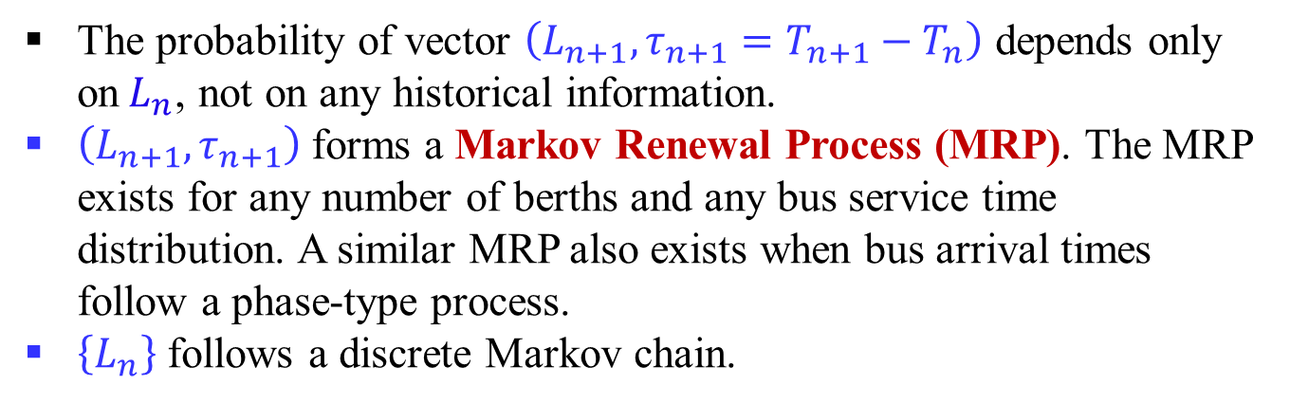



No-overtaking bus stops – Analytical Model
An exact analytical solution to the queueing model with serial berths when bus arrivals are Poisson.
Poisson arrivals
passenger platform
$$L_{n}=1$$
n-th jump time, $T_{n}$
$$L_{n+1}=2$$
$$T_{n+1}$$
The probability of vector $\left(L_{n+1}, {τ_{n+1}=T}_{n+1}−T_{n}\right)$ depends only on$L_{n}$, not on any historical information.
$\left(L_{n+1},τ_{n+1}\right)$ forms a Markov Renewal Process (MRP). The MRP exists for any number of berths and any bus service time distribution. A similar MRP also exists when bus arrival times follow a phase-type process.
$\left\{L_{n}\right\}$ follows a discrete Markov chain.
Notes:
First let’s look at no-overtaking stops, for which I developed an exact analytical solution when bus arrivals are reasonably assumed to follow a Poisson process.
For illustration, I will show a simple example of a 2-berth stop. Note the moment when both berths become empty. I call this moment the n-th jump time, Tn. Since the Poisson bus arrivals are memoryless, how the system would evolve in the future depends only on the number of queued buses at this jump time, which is denoted as Ln. In this case, L_n = 1.
This queued bus immediately enters the downstream berth. And then 3 more buses come, and after a while two buses depart. This is the next jump time, and we record the system state L_n+1. Note that the joint distribution of L_n+1 and the interval between these two jump times depends only on L_n. Thus the sequence of this tuple follows a so-called Markov renewal process. This process is the key to my analytical solution. Specifically, the state variable L_n forms a discrete Markov chain, which is analytically solvable.
I want to mention that this methodology using MRP will be applied to other serial queueing systems in the later slides.

Slide 20
No-overtaking bus stops
Bus flow served by each berth (normalized)
Average bus delay (normalized)
1 berth
Notes:
I will skip the mathematical details here and jump to the results. Among the many interesting results and findings obtained from the model, I will just show you an example. Look at the average allowable bus flow per berth plotted against the target average bus delay. Both variables are normalized by assuming the average bus service time is 1.
This blue curve is for a single-berth stop.

Slide 21
No-overtaking bus stops
Bus flow served by each berth (normalized)
2 berth
Average bus delay (normalized)
1 berth
Notes:
And look at the left side when the target bus delay is low, we see that adding more berths to a stop can improve the allowable flow per berth.

Slide 22
No-overtaking bus stops
Bus flow served by each berth (normalized)
3 berths
2 berths
Average bus delay (normalized)
1 berth

Slide 23
No-overtaking bus stops
Bus flow served by each berth (normalized)
4 berths
3 berths
2 berths
Average bus delay (normalized)
1 berth
Notes:
This finding actually disagrees with what has been claimed in the literature, including the HCM.

Slide 24
No-overtaking bus stops
Bus flow served by each berth (normalized)
1 berth
2 berths
4 berths
3 berths
2 berths
Average bus delay (normalized)
1 berth
Notes:
Now switch to the right-hand-side when the target bus delay is large, we find that adding berths will reduce the average allowable flow.

Slide 25
No-overtaking bus stops
Bus flow served by each berth (normalized)
1 berth
2 berths
3 berths
4 berths
3 berths
2 berths
Average bus delay (normalized)
1 berth

Slide 26
No-overtaking bus stops
Bus flow served by each berth (normalized)
1 berth
2 berths
3 berths
4 berths
4 berths
3 berths
2 berths
Average bus delay (normalized)
1 berth
Notes:
And this part is where it’s beneficial to split a large stop into smaller stops.

Slide 27
Comparison with classical queueing systems
Bus flow served by each berth (normalized)
Classical queueing
systems
4 berths
3 berths
2 berths
Average bus delay (normalized)
1 berth

Slide 28
Limited-overtaking bus stops
passenger platform
There exists a more complicated MRP.
To simplify the analysis, we here only consider the maximum bus flow that can be served by a stop; i.e., the stop’s capacity. In this extreme case, MRP reduces to a (normal) renewal process.
Notes:
Now we will look at limited-overtaking stops, recall that here buses are allowed to make overtaking maneuvers only when they exit the stop, but not when they enter a berth. My analytical solution comes from a similar, but more complicated Markov renewal process. And here for simplicity I consider the extreme case where a bus queue is always present at the stop, i.e., where the target bus delay is infinity. In this case the MRP reduces to a regular renewal process.

Slide 29
Limited-overtaking bus stops
Intuitively, a stop’s capacity increases when bus overtaking maneuvers are allowed (even in a limited fashion).
This intuition, although consistent with the literature (TRB, 2000; 2003; Papacostas, 1982; Gardner, 1997), is not true however.
Notes:
Before presenting the results, let me ask you a question: Would this limited-overtaking policy improve the allowable bus flow? Intuitively, we would think so coz we relaxed a restriction of bus operations and buses enjoy more freedom, and this is also what was claimed in the literature.
However surprisingly, our finding is on the contrary.

Slide 30
Comparison between no-overtaking and limited-overtaking
2-berth stops
Average capacity per berth (normalized)
No-overtaking
Std. dev. of bus dwell time
Notes:
And here is what our models predict for the allowable flows of 2-berth no-overtaking and limited-overtaking stops against the coefficient of variation in bus service time, denoted as Cs.
We do see a benefit of allowing bus overtaking but only when Cs is high. And when Cs is low, the limited-overtaking policy significantly undermines the stop’s allowable flow.

Slide 31
Comparison between no-overtaking and limited-overtaking
3-berth stops
Average capacity per berth (normalized)
Limited-overtaking
No-overtaking
Std. dev. of bus dwell time
Notes:
And things become worse for stops with more berths.

Slide 32
Comparison between no-overtaking and limited-overtaking
3-berth stops
Average capacity per berth (normalized)
Limited-overtaking
No-overtaking
Prohibiting overtaking
Allowing overtaking
Std. dev. of bus dwell time
Notes:
The results show that we should prohibit all overtaking maneuvers when Cs is below a threshold. Note that in this case prohibiting overtaking will benefit both buses and cars because it eliminates disruption to car traffic in the adjacent lane.
And if we allow bus overtaking only when Cs is greater than the threshold, we will get the upper envelope of these two curves.

Slide 33
Why limited-overtaking is damaging?
Waste!
Selfish driver behavior
Notes:
But we’re not satisfied yet. We want to seek better solutions by understanding why overtaking is bad? The explanation is actually simple.
For the two buses under service, the upstream bus finishes just a little bit earlier than the downstream one, and exits the stop by overtaking. If bus drivers are greedy, the emptied berth will be immediately occupied by the bus at the head of the queue. While the downstream bus departs soon after, the berth will remain empty for a while because the current bus in the upstream berth has just started its service. So the berth is wasted.

Slide 34
Why limited-overtaking is damaging?
More waste of time occurs at the downstream berth when the difference between the two buses’ dwell times is small (small std. dev.).
Notes:
This also explains why overtaking is bad when Cs is low. Because…

Slide 35
Real-time control of bus operations
Can we temporarily stop drivers’ selfish behaviors?
Notes:
So a potential solution is to block those greedy drivers from entering the emptied upstream berth when the maneuvers become damaging. Following this thought, I developed a simple real-time control strategy that opts to block those greedy buses or to let them in. And the performance of this control strategy depends on how much we know about bus service times.

Slide 36
Real-time control of bus operations
Average capacity per berth (normalized)
Optimally controlled buses when knowing
the distribution of bus dwell times
Limited-overtaking
No-overtaking
Std. dev. of bus dwell time
Notes:
If we only know the distribution of bus service times, then the control can barely buy us any improvement; see the dashed purple curve that practically sits on the upper envelope of the two previous curves; another kinda surprising result.

Slide 37
Real-time control of bus operations
Average capacity per berth (normalized)
Optimally controlled buses when knowing
the distribution of bus dwell times
Optimally controlled buses when knowing all bus dwell times
Limited-overtaking
No-overtaking
Std. dev. of bus dwell time
Notes:
But suppose we can accurately predict all the bus service times, then the blue dash-dot curve shows what control can achieve. The real benefit of control will be between these two curves when the predictions of bus service times are made with a certain level of accuracy.

Slide 38
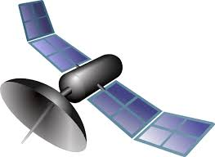
Real-time control of bus operations
Case of light congestion
GPS
Notes:
But suppose we can accurately predict all the bus service times, then the blue dash-dot curve shows what control can achieve. The real benefit of control will be between these two curves when the predictions of bus service times are made with a certain level of accuracy.

Slide 39
Bus stops near signalized intersections
A near-side stop: Buses can only travel in the dedicated bus lane; no bus overtaking is allowed.
Bus lane
buffer
Notes:
Okay, so far we have studied isolated stops, next let’s look at a stop placed upstream of a traffic signal, the so-called near-side stop. This is also very common in the real world. The lane area between the stop and the intersection can be used as a buffer for storing buses that are waiting for the red signal.

Slide 40
Bus stops near signalized intersections
At a near-side stop, buses queued in the buffer during the red signal can spill over to the stop and block dwelling buses.
A queueing system with tandem servers connected with a polling system (traffic signal).
No Markov property ☹
We formulated an approximation (error within 5%).
Bus lane
buffer
Notes:
And if the buffer is too small, such that it is filled up by buses discharged from the stop during a red period, then buses in the stop would be blocked from departing the stop. Here we assume that buses can’t leave their lane.
This phenomenon makes the problem even more complicated than the isolated stop case. But we still…

Slide 41
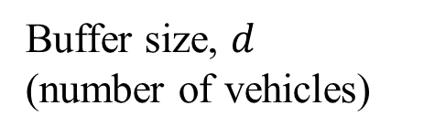

Bus stops near signalized intersections
Stop capacity (normalized)
Buffer size, $d$
(number of vehicles)
Bus lane
$$d$$
Notes:
And if the buffer is too small, such that it is filled up by buses discharged from the stop during a red period, then buses in the stop would be blocked from departing the stop. Here we assume that buses can’t leave their lane.
This phenomenon makes the problem even more complicated than the isolated stop case. But we still…

Slide 42




Bus stops near signalized intersections
The capacity of a far-side stop located $d$ from the intersection is approximately the same as that of a near-side one.
Bus lane
$$d$$
$$≅$$
Bus lane
$$d$$
Notes:
The above models are obtained for near-side stops. So what if the stop is located downstream of the signal, the so-called “far-side” stop?
Fortunately, we found that in most cases a far-side stop is the mirror of its near-side counterpart. Thus the approximation models we obtained above can be applied to far-side stops without changes.

Slide 43
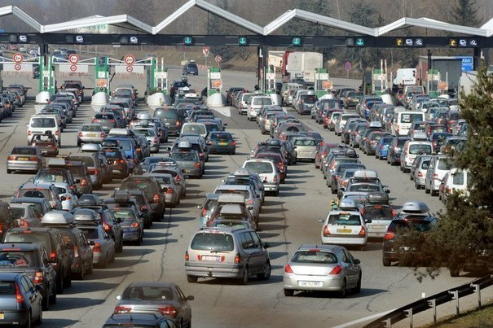
Tandem toll booths
buffer
Notes:
Okay, let me briefly summarized the presentation. I studied serial queueing systems which are widely applied in the transportation field. I developed analytical models using Markov renewal processes, and of coz the methodology can be used for other queueing systems of this type. Results from my models have many practical implications on design, operation, and control of tandem bus stops and toll stations, and potentially other transportation systems.

Slide 44
Use buffer
buffer
Reference: Hall and Daganzo (1983)
Notes:
But actually we can do better by introducing vehicle buffer between the two tandem booths.

Slide 45
Use buffer
A vehicle that has
finished its service
Notes:
The buffer helps in two ways. First, if the car served by the upstream booth finishes earlier than the downstream one, it can enter the buffer and make the upstream booth open for queued cars.

Slide 46
Use buffer
A vehicle that is
waiting to be served
Mutual blockage between
vehicles is reduced!
Notes:
On the other hand, if we allow some unserved cars to enter the buffer together with these two cars that enter the booths, then if the downstream car departs first, an unserved car in the buffer can enter this emptied booth to be served.
In both cases, the buffer can potentially reduce the mutual blockage between vehicles, and thus improve the discharge car flow.

Slide 47
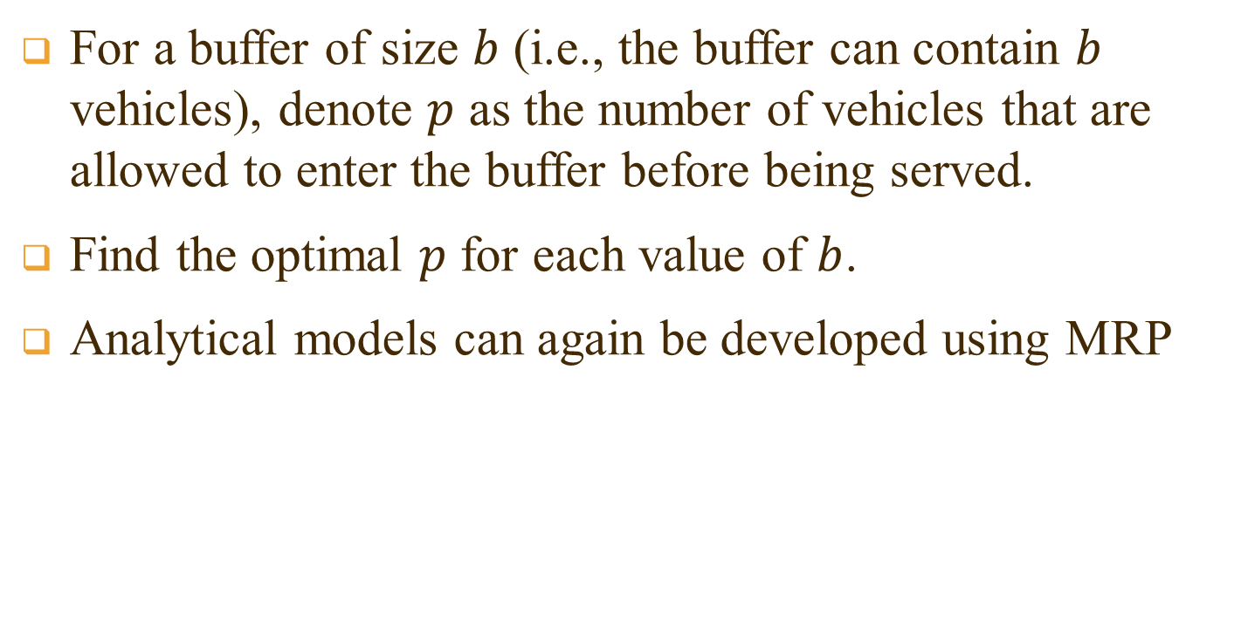
Optimal use of buffer
For a buffer of size $b$ (i.e., the buffer can contain $b$ vehicles), denote $p$ as the number of vehicles that are allowed to enter the buffer before being served.
Find the optimal $p$ for each value of $b$.
Analytical models can again be developed using MRP
Notes:
And we can control the number of unserved cars, p, that are allowed to enter the buffer every time. To this end I again developed models using MRP, and used the models to find the optimal p.

Slide 48

Optimal capacity of buffered tandem toll booths
Vehicle capacity per lane (normalized)
$$b=0$$
Std. dev. of vehicle processing time
Notes:
So here are my results. We find the car discharge flow gradually increases as the buffer size increases from 0 to 4.

Slide 49

Optimal capacity of buffered tandem toll booths
Vehicle capacity per lane (normalized)
$$b=1$$
$$b=0$$
Std. dev. of vehicle processing time
Notes:
So here are the results. We find the car discharge flow gradually increases as the buffer size increases from 0 to 4.

Slide 50

Optimal capacity of buffered tandem toll booths
Vehicle capacity per lane (normalized)
$$b=2$$
$$b=1$$
$$b=0$$
Std. dev. of vehicle processing time
Notes:
So here are the results. We find the car discharge flow gradually increases as the buffer size increases from 0 to 4.

Slide 51

Optimal capacity of buffered tandem toll booths
Vehicle capacity per lane (normalized)
$$b=3$$
$$b=2$$
$$b=1$$
$$b=0$$
Std. dev. of vehicle processing time
Notes:
So here are the results. We find the car discharge flow gradually increases as the buffer size increases from 0 to 4.

Slide 52

Optimal capacity of buffered tandem toll booths
Vehicle capacity per lane (normalized)
$$b=4$$
$$b=3$$
$$b=2$$
$$b=1$$
$$b=0$$
Std. dev. of vehicle processing time
Notes:
Each curve is plotted with the optimal choices of p. The optimal p actually is a function of the coefficient variation in service time, Cs.

Slide 53
Concluding Remarks
Queueing systems with tandem servers widely exist in the transportation field. Due to the mutual blockage between customers under service (vehicles), theories of classical queueing systems do not apply.
Different methods (method of embedded Markov chain, approximation, etc.) can be chosen to solve various queueing systems due to their distinct nature.
These queueing systems are building blocks of more complex systems like arterials or networks. Solutions to these queueing systems can inform means to mitigate congestions within the systems, and can inspire smart solutions to more complicated problems.
Notes:
Okay, let me briefly summarized the presentation. I studied serial queueing systems which are widely applied in the transportation field. I developed analytical models using Markov renewal processes, and of coz the methodology can be used for other queueing systems of this type. Results from my models have many practical implications on design, operation, and control of tandem bus stops and toll stations, and potentially other transportation systems.

